Slide 1
Neural Networks and Deep Learning
By SIMPLE IMAGE SIGNAL PROCESSING USING GLOBAL CONTEXT GUIDANCE
Omar Elezabi, Marcos V. Conde, Radu Timofte
Computer Vision Lab, CAIDAS & IFI, University of Wurzburg
IEEE International Conference on Image Processing (ICIP) 2024
Git hub link : https://github.com/Meghana09G/Mini-project.git
Resarch paper : https://arxiv.org/abs/2404.11569
Meghana Gudipati
700761933

Slide 2
Project overview
Objective
Enhance images by utilizing global contextual features , particularly histogram information , to improve visual quality using simple image processing techniques .
Goal : enhance image using global context features
Core idea : use techniques like histogram equalization guided by global features to improve visual quality
Libraries : numpy, opencv python , matplotlib

Slide 3
Conceptual steps
Load input image
Global feature extraction
Histogram : to understand intensity distribution
Mean , variance : basic image stats
Gradients : to capture edge changes
Image enhancement
uses HISTOGRAM EQUALIZATION to enhance contrast
Processes the image using the extracted global features
Output enhanced image
Side by side comparison between original and enhanced images
Clear input in contrast

Slide 4


Slide 5


Slide 6
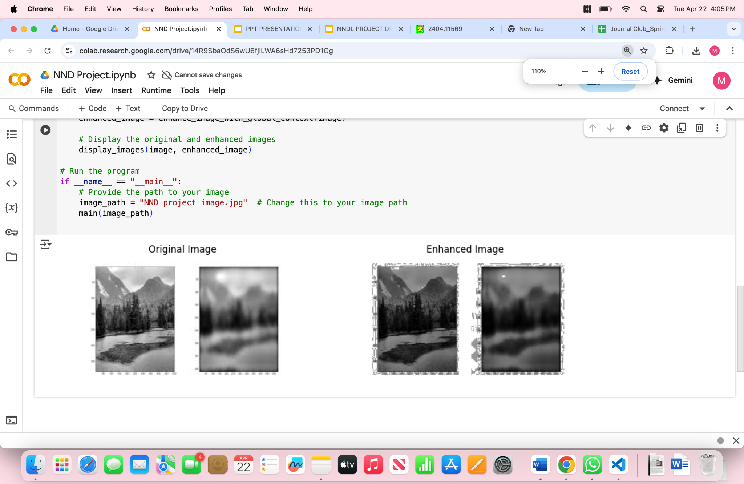

Slide 7
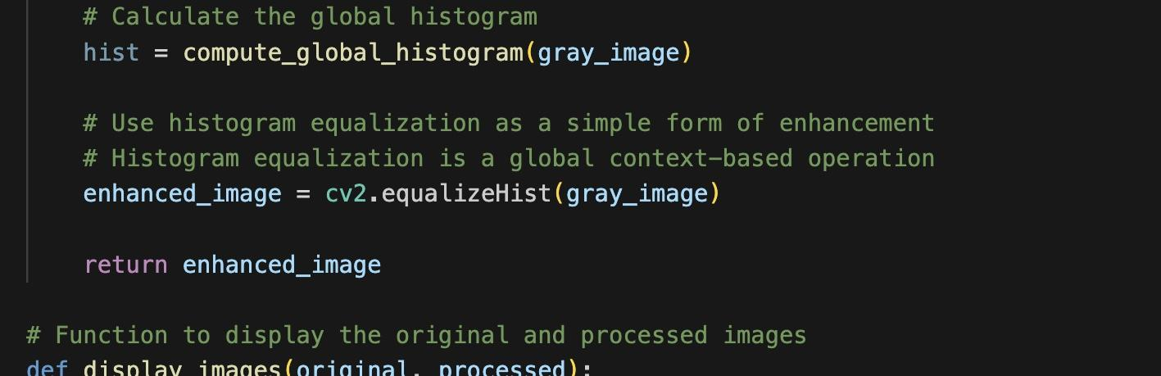
Code snippet - HISTOGRAM COMPUTATION
Computes the histogram of grayscale image
Helps visualize the global intensity distribution

Slide 8
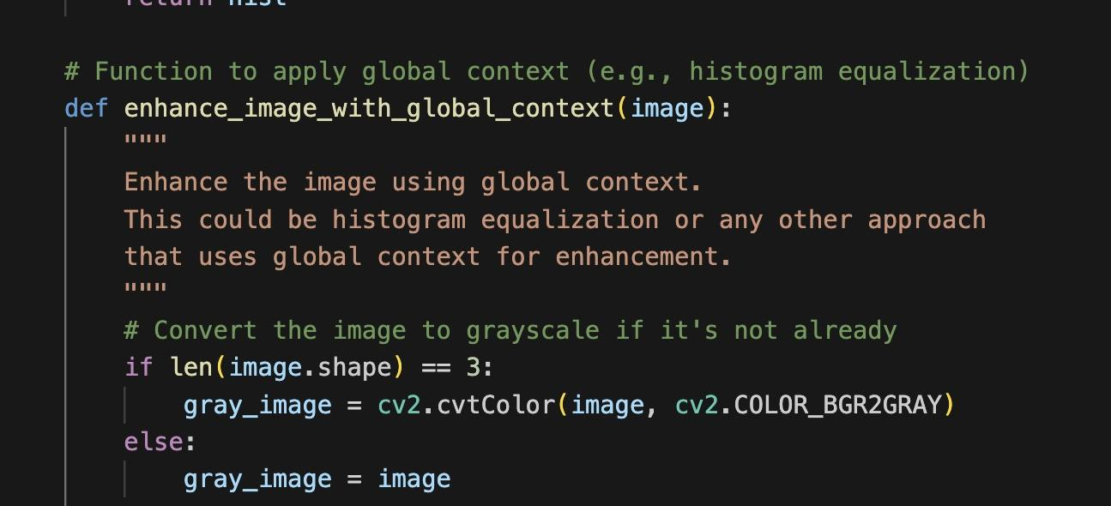

Enhancement with global context
1.Applies histogram equalization
2. Enhances contrast using global pixel distribution

Slide 9
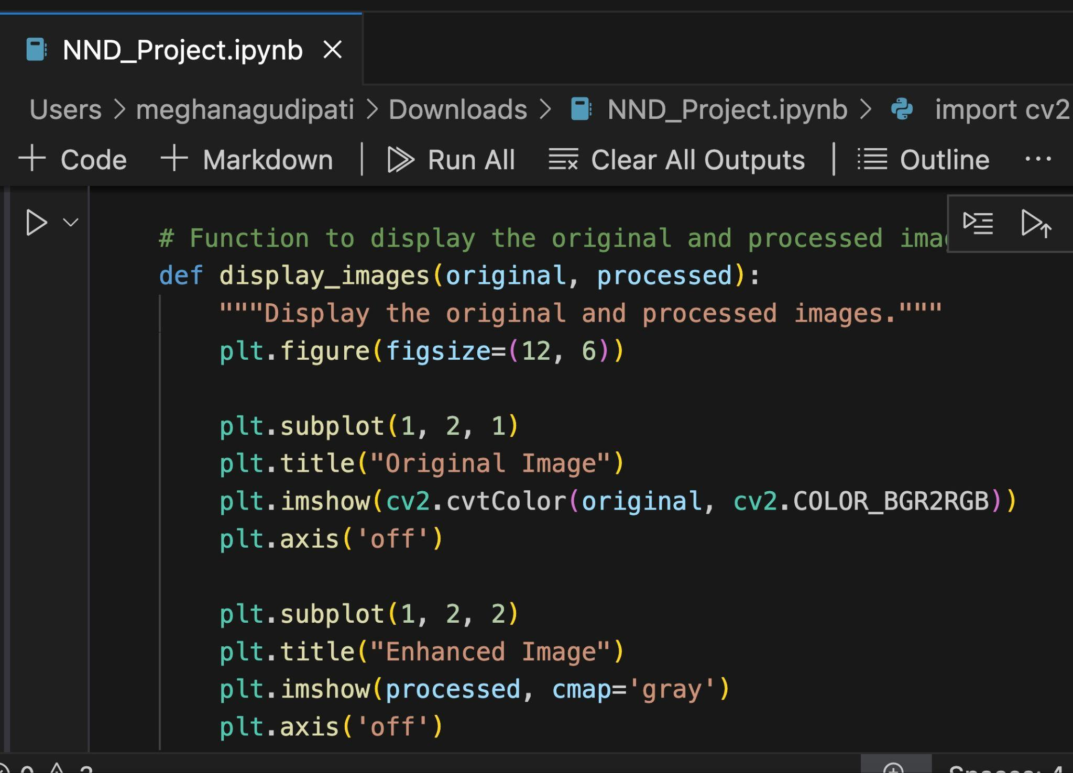
Hypothesis support
Compares original and enhanced images side by side

Slide 10
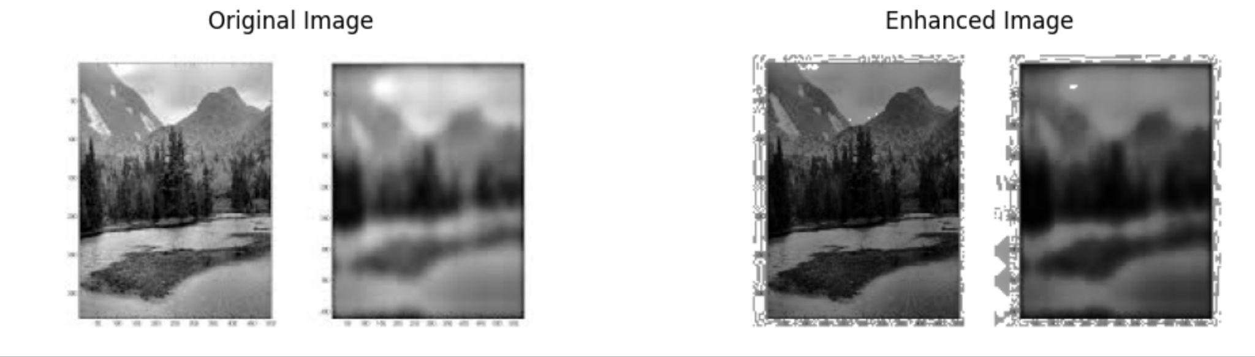
Outputs :

Slide 11
Potential extensions :
Global Edge Detection
Image Denoising
Segmentation using global texture or color
Neural-guided image enhancement

Slide 12
How to implement
?
Install required libraries pip install numpy opencv-python matplotlib
Run the code in Colab or locally
Provide path to your input image
View the comparison output

Slide 13
Conclusion
This project demonstrates
Used global context ( histogram ) to enhance images
Improved image contrast through histogram equalization
Better contrast
Improved visibility in low light regions
More balanced intensity distribution
Simple , effective and can be extended to advance techniques
This method is simple , efficient and extensible , laying the groundwork for

Slide 14
THANK YOU

